Slide 1


Slide 2

Major Project-I (01CE0716)
Review - 3 (30/08/2025)
Early Detection of Diabetes Using Supervised Classification Algorithm
Team ID: 7CE_046
Team Member 1: Raj Mungara (92200103223) (7TC3)
Team Member 2: Darshan Vasoya (92200103199) (7TC3)
Team Member 3: Rupesh Rudakiya (92200103222) (7TC3)
Guided By
Prof. Dhara Joshi
Department of Computer Engineering, Faculty of Engineering & Technology

Slide 3
Outline
Abstract
Introduction
Objective
Literature Review
Tools & Technology
Dataset
Methodology
Result and Discussion
Conclusion
References

Slide 4
Abstract
Diabetes is caused due to increase in blood sugar level and it is considered as one of the deadliest and most chronic disease. If it is untreated or unidentified there will be a chances of occurring many complications. The rise in machine learning approaches solves this critical problem. The motive of this study is to design a model which can prognosticate the likelihood of diabetes in patients with maximum accuracy. Therefore, Machine learning classification algorithms namely Logistic Regression, Decision tree and SVM are used in this experiment to detect diabetes at an early stage. Experiments are performed on Real Diabetes Dataset (RDD) which is sourced from Kaggle machine learning repository.The performances of these algorithms are evaluated on various measures like Precision, Accuracy, F-Score, and Recall.

Slide 5
Introduction
Diabetes is one of the most noxious diseases in the world.
Diabetes is caused because of obesity, high blood glucose levels.
It affects the hormone insulin, resulting in abnormal metabolism of carbs and an increase in the level of sugar in the blood.
The types of Diabetes are: Type 1, Type 2, and Type 3
Type 1 - diabetes means that the immune system is compromised, and the cells fail to produce insulin in sufficient amounts.
Type 2 - diabetes means that the cells produce a low quantity of insulin, or the body can’t use the insulin correctly.
Type 3 - Gestational diabetes is a type of diabetes that develops during pregnancy. Gestational diabetes is usually diagnosed in the 24th to 28th week of pregnancy.
Machine learning is considered to be one of the most important artificial intelligence features that supports the development of computer systems having the ability to acquire knowledge from past experiences with no need for programming for every case.

Slide 6
Objective
To predict whether a person is diabetic or not at an early stage.
To understand and analyse the present diabetics diseases.
To reduce the processing time of data sets we can use machine learning techniques.
To evaluate the performance of the proposed model.

Slide 7
Literature Review
Author | Year | Dataset | Title | Accuracy | Strengths | Limitations | Model Used
Taminul Islam et al. | 2024 | Bangladeshi clinical records (3,837) | Early-Stage Diabetes Risk Prediction Using Supervised ML Algorithms | 96.55% | Real patient data, RF accuracy, compared 5 models | Regional data, class imbalance | Random Forest, Naive Bayes, SVM, Logistic Regression, Decision Tree
Moon, S.-Y. et al. | 2021 | Korean cohort (14,977) | Prediction of Type 2 Diabetes Using Logistic Regression | AUC 0.94 | Large cohort, high AUC (0.94), real-world data | Single model, no ML comparison | Logistic Regression
Vakil et al. | 2021 | Sylhet Hospital, Bangladesh | Explainable Predictions Using ML for Early Diabetes | 97.56% | RF , SHAP for interpretability | Private dataset, local focus | Random Forest, SVM, ANN, KNN, XGBoost, Decision Tree (with SHAP)
Bhat et al. | 2022 | Bandipora hospital (Kashmir) | ML-Based Early Prediction of Diabetes in Kashmir | 94% | RF , compares 6 models, regional clinical data | Limited external validation | Random Forest, MLP, SVM, Gradient Boosting, Logistic Regression, Decision Tree
Aditi Site, Jari Nurmi | 2023 | Multi‑sensor data: ECG, glucose, accelerometer, breathing (wearable) | Machine‑learning Based Diabetes Prediction Using Multi‑Sensor Data | ~92.2% | Multi-sensor fusion improves accuracy by 4–5%; wearable, non-invasive; feature optimization | Small sample (29 people), limited generalizability | XGBoost

Slide 8
Literature Review
Author | Year | Dataset | Title | Accuracy | Strengths | Limitations | Model Used
Ugboaja et al. | 2024 | Pima Indians Dataset | Advanced Diabetes Prediction Using RF | 92% | RF achieved , strong metrics | Public dataset, limited features | Random Forest
Zill Huma et al. | 2024 | Kaggle (27,690 samples) | Federated ML for Early Diabetes Prediction | 90% | Privacy-preserving, scalable, accuracy | Infrastructure complexity | XGBoost (Federated Learning)
Mehmet A. Bülbül | 2024 | UCI early-stage diabetes dataset | Hybrid Deep Learning Model for Diabetes Prediction | High | Outperformed traditional ML, GA + Autoencoder | Complex, no external data | GA + Stacked Autoencoder + Softmax
Jahangir et al. | 2017 | Pima Indians Dataset | ECO-AMLP: Outlier + MLP Model | 88.7% | Outlier-aware, accuracy | Only tested on benchmark dataset | Outlier detection + MLP
Koumousis et al. | 2020 | Pima Indians Dataset | Deep Learning for Diabetes Prediction | 94.07% | DL accuracy, superior to ANN, DT | Black-box, small dataset | Deep Learning (Multi-layer Perceptron)

Slide 9
Literature Review
Author | Year | Dataset | Title | Accuracy | Strengths | Limitations | Model Used
Ashiquzzaman et al. | 2017 | Pima Indians Dataset | Reducing Overfitting in DNN for Diabetes | Improved | Dropout improves model generalization | Benchmark-only data, not clinically validated | DNN with Dropout
Anonymous | 2022 | Pima Indians Dataset | Application of ML for Type 2 Diabetes Detection | 79.6% (KNN), 77.2% (NB) | K-NN () and NB () worked well | Basic models, modest accuracy | K-NN, Naive Bayes, Decision Tree, Logistic Regression, SVM
Nrusingha Tripathy et al | 2024 | Pima Indians Diabetes Dataset (768 samples) | A Comparative Analysis of Diabetes Prediction Using ML and DL Algorithms in Healthcare | LSTM: Best; others range from 76%–84% | Compared 7 ML/DL methods, LSTM superior, strong focus on preprocessing (age, BMI, BP buckets) | Limited dataset, lack of external validation | Logistic Regression, SVM, KNN, Random Forest, CART, XGBoost, LightGBM, DNN, LSTM
Owess et al. | 2024 | Palestinian STEPS Survey | Supervised ML-Based Models for Blood Sugar | 97.4% | RF , rich feature set | Survey-based, costly to replicate | Random Forest
Huma et al. (again) | 2024 | Kaggle | Federated XGBoost for Diabetes | High | Reiterated privacy strength of federated ML | Repeats Kaggle data limitation | XGBoost (Federated)

Slide 10
Tools
Python – Core programming language used for implementation.
Jupyter Notebook / Google Colab – For writing, testing, and visualizing code interactively.
Tableau / Power BI
– For financial data visualization

Slide 11
Technology
Pandas – Data manipulation and preprocessing.
NumPy – Numerical computations and array operations.
Matplotlib & Seaborn – Data visualization and EDA (Exploratory Data Analysis).
Scikit-learn – Machine learning algorithms and model evaluation tools.

Slide 12
Technology
5. Supervised Machine Learning Algorithms: – Logistic Regression – Random Forest – Decision Tree etc…
6. Evaluation Metrics: – Accuracy, Precision, Recall.

Slide 13
Dataset
Dataset Overview:
Records: 520
Features: 17
Target Variable: class (Positive/Negative)
Format: CSV
Type: Clinical, symptom-based diagnostic dataset

Slide 14
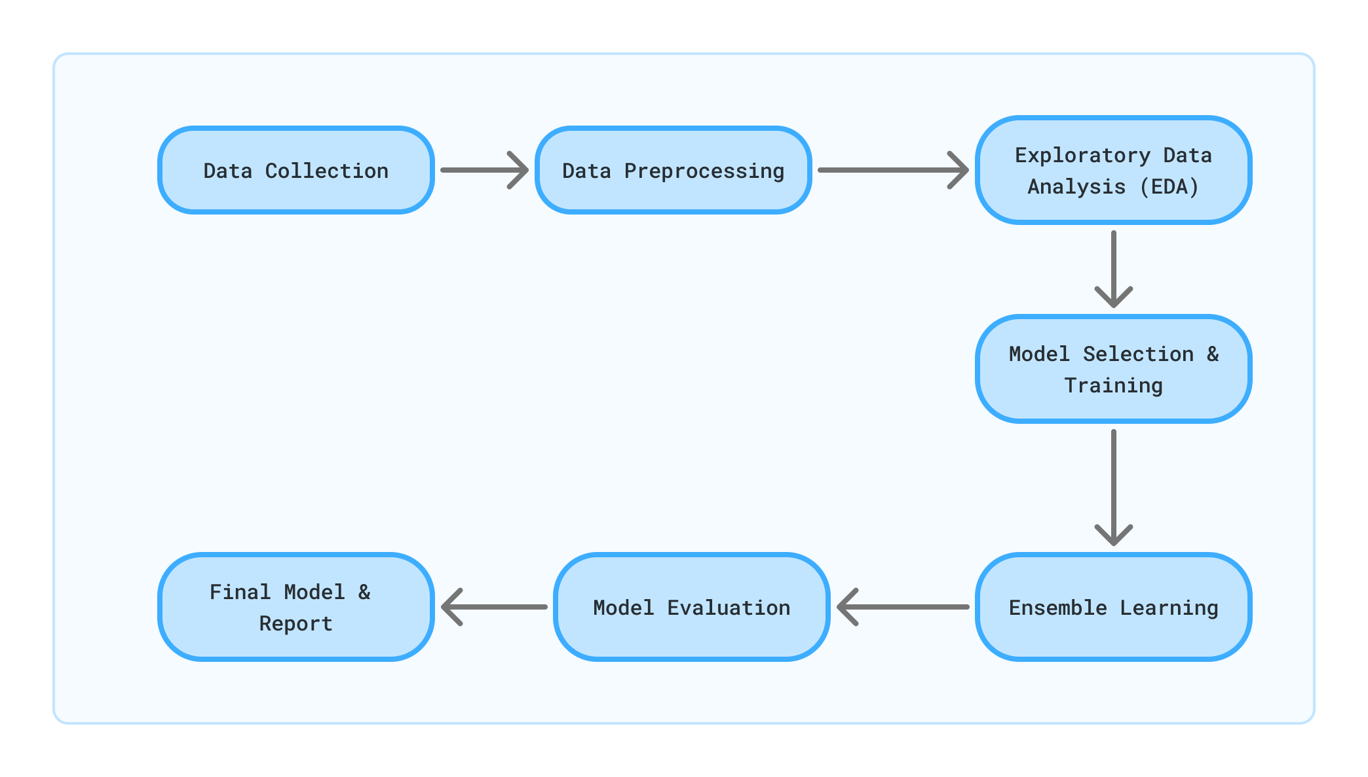
Methodology

Slide 15
Result and Discussion
The proposed approach uses different classification and ensemble methods and implemented using python.
These methods are standard Machine Learning methods used to obtain the best accuracy from data.
In this work we see that random forest classifier achieves better compared to others.
Overall, we have used best Machine Learning techniques for prediction and to achieve high performance accuracy.
Figure shows the result of these Machine Learning method
Model | Accuracy | Recall | Precision
Decision Tree Classifire | 95..51 | 95.5128 | 95.5128
Support Vectors Classifier | 91.67 | 91.6667 | 91.6667
Logistic Regression | 94.87 | 94.8718 | 94.8718
Model | Accuracy | Recall | Precision
Decision Tree Classifire + K-Nearst Neighbor | 98.51 | 97.5128 | 97.5128
Support Vectors Classifier | 91.67 | 91.6667 | 91.6667
Logistic Regression | 94.87 | 94.8718 | 94.8718
Table 1.0 : previous(Without Ensemble) table
Table 1.1 : improve(With Ensemble) model performance

Slide 16
Conclusion and Future work
Conclusion:-
I have completed the first half of my project, which focuses on using supervised machine learning algorithms to detect diabetes early. I have successfully collected the dataset, cleaned the data, selected the important features, and started applying different classification algorithms. These steps have helped me understand how machine learning can be used to find patterns in health data that may indicate early signs of diabetes.
The initial results from the models show that this approach has good potential. Some algorithms are giving better results than others, but I still need to test them fully. This part of the project has helped me learn the importance of proper data preparation, feature selection, and the need to choose the right model for accurate predictions.
Since the project is not fully complete, I will be making some changes based on the final evaluation results. These changes will help improve the model's accuracy, make the prediction more reliable, and help in detecting diabetes at an early stage, which can save lives and reduce health risks.
This halfway point gives me confidence that with further improvement and testing, the final model will be more effective and useful.

Slide 17
References
[1] T. Islam, T. R. Mona, M. R. Sadik et al., “Early-Stage Diabetes Risk Prediction Using Supervised Machine Learning Algorithms,” Journal of Engineering Research and Reports, vol. 24, no. 3, pp. 1–12, 2024.
[2] S.-Y. Moon et al., “Prediction of Type 2 Diabetes Using Logistic Regression in a Korean National Cohort,” Diabetes & Metabolism Journal, vol. 45, no. 6, pp. 878–889, 2021.
[3] V. Vakil, S. Pachchigar, C. Chavda, and S. Soni, “Explainable Predictions of Different Machine Learning Algorithms Used to Predict Early Stage Diabetes,” arXiv preprint, arXiv:2111.09939, 2021.
[4].S. S. Bhat et al., “Prevalence and Early Prediction of Diabetes Using Machine Learning in North Kashmir: A Case Study of District Bandipora,” Health Science Reports, vol. 5, no. 5, e723, 2022.
[5].S. G. Ugboaja et al., “Advanced Diabetes Prediction Using Supervised Machine Learning Technique: Random Forest,” International Journal of Scientific Research and Engineering Development, vol. 7, no. 1, pp. 314–320, 2024.
[6].Z. E. Huma, N. Tariq, and S. Zaidi, “Predictive Machine Learning Models for Early Diabetes Diagnosis: Enhancing Accuracy and Privacy with Federated Learning,” Journal of Computer-Based Instruction, vol. 18, no. 2, pp. 45–53, 2024.
[7].M. A. Bülbül, “A Novel Hybrid Deep Learning Model for Early Stage Diabetes Risk Prediction,” Journal of Supercomputing, vol. 80, no. 3, pp. 1412–1431, 2024.
[8].M. Jahangir et al., “ECO-AMLP: A Decision Support System Using an Enhanced Class Outlier with Automatic Multilayer Perceptron for Diabetes Prediction,” arXiv preprint, arXiv:1706.07679, 2017.

Slide 18
References
[9]. M. Koumousis et al., “Deep Learning Approach for Diabetes Prediction Using PIMA Indian Dataset,” Journal of Medical Systems, vol. 44, no. 10, pp. 1–10, 2020.
[10]. A. Ashiquzzaman et al., “Reduction of Overfitting in Diabetes Prediction Using Deep Learning Neural Network,” in Proc. 20th International Conference of Computer and Information Technology (ICCIT), Dhaka, Bangladesh, 2017, pp. 1–6.
[11].Anonymous, “Application of Machine Learning Models for Early Detection and Accurate Classification of Type 2 Diabetes,” BioMed Research International, vol. 2022, Article ID 101112, 2022.
[12].M. Owess et al., “Prediction of Blood Sugar Level Using Supervised Machine Learning-Based Models,” Electronics, vol. 13, no. 1, p. 92, 2024.
[13].Z. E. Huma et al., “Federated XGBoost for Diabetes Diagnosis Using Distributed Health Records,” Journal of Computer-Based Instruction, vol. 18, no. 2, pp. 60–67, 2024.
[14].F. Mohsen and Z. Shah, “Improving Early Prediction of Type 2 Diabetes Mellitus with ECG-DiaNet: A Multimodal Neural Network,” arXiv preprint, arXiv:2504.05338, 2025.
[15].N. Tripathy, A. Samanta, and B. P. Mishra, “A Comparative Analysis of Diabetes Prediction Using Machine Learning and Deep Learning Algorithms in Healthcare,” International Journal of Information Technology and Computer Science, vol. 16, no. 1, pp. 35–44, 2024.

Slide 19


